Slide 1

Graduation Project: Blood donation: BDP Website easing the Process of Blood donation in Alexandria
Supervised by:
Dr. Yasser Abdelghafar
Submitted by:
Reem Hassan Abdu A.Sakoury Aamen Youssry Gamal ElDin
Nada Ibrahim El-Sayed Noura Abdelmoneim Sheth
Mohamed Mostafa Ahmed Yara HossamEldin Mohamed Basha
Ahmed Youssef ELAlem Eman Ahmed Baioumy Aly
Omnia Osama SaEED Abdelaziz Mohamed Abdelaziz
July 2019

Slide 2
Introduction

Slide 3
Blood shortage is a common problem nowadays
It's always hard to find the needed blood type immediately
BDP idea is based on connecting the blood banks with hospitals and donors together in one place

Slide 4
Problem Huge shortage of blood at blood banks and hospitals for the last 20 years in Egypt, reasons might be:
The less awareness of the importance of donation
The large number of accidents and explosions
And the most important is there is no system that helps in reaching the missing or needed blood type
Many people can lose their life daily because of shortage in their blood type in blood banks or hospitals
So, imagine if we ease this process to the patients, hospitals and blood banks by a simple idea in an easy way!

Slide 5
Idea:
Our website is aiming to ease the process of blood donation specifically inside Alexandria, and any shortage in any blood type be easily known and easily to be found as fast as possible.
The website allows communication between the hospitals, blood banks, and the outside users to announce if there any blood type needed in a specific hospital with brief details around the patient case, and where exactly the donor can go and donate. Also, it offers a sign up option for the users to get notifications by any announcement.
By the end, saving a life is a great honor for any human, we are meant to rescue each other, and here is our idea is to help you to get the honor to save LIVES.

Slide 6
Objectives
Reduce processing time and solve blood shortage problem
Blood banks can fulfill their need for blood donors
In case of emergencies, patients can find their blood type easily and quickly every second passes makes a great difference in saving a life
Save people a lot of time searching Facebook groups as BDP collects all cases in one place in an organized way

Slide 7
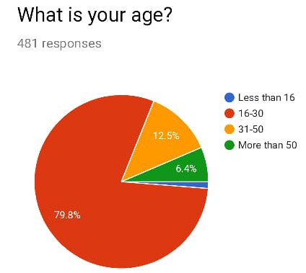
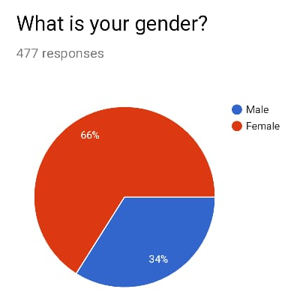
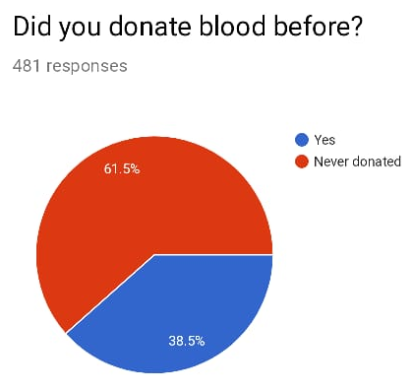
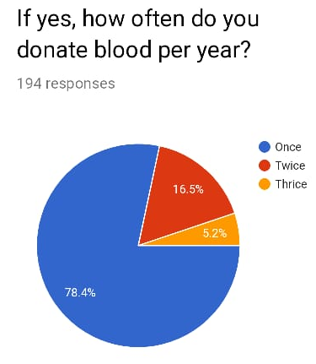
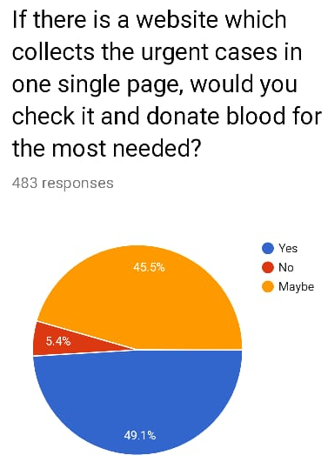
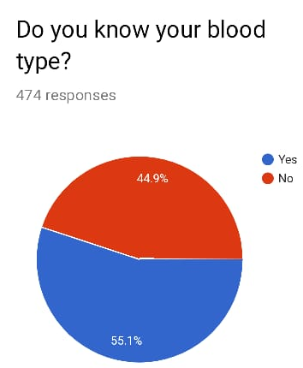
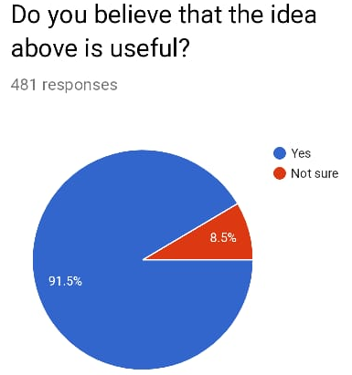
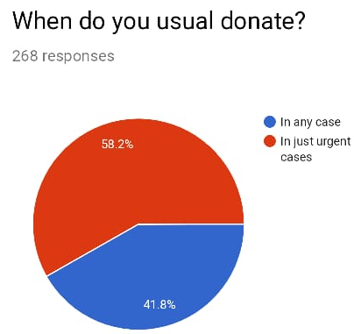

Slide 8


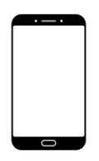





BDP features
Donors can filter cases by blood type and location
A communication channel between donors and blood banks
Mobile Friendly
Easy to use and users can send their inquiries by filling the feedback form or messaging our Facebook page
Donors can opt for receiving notifications by email periodically (notifications period is defined by users upon registration)
Providing all needed information to people willing to donate (Information is gathered from doctors)

Slide 9
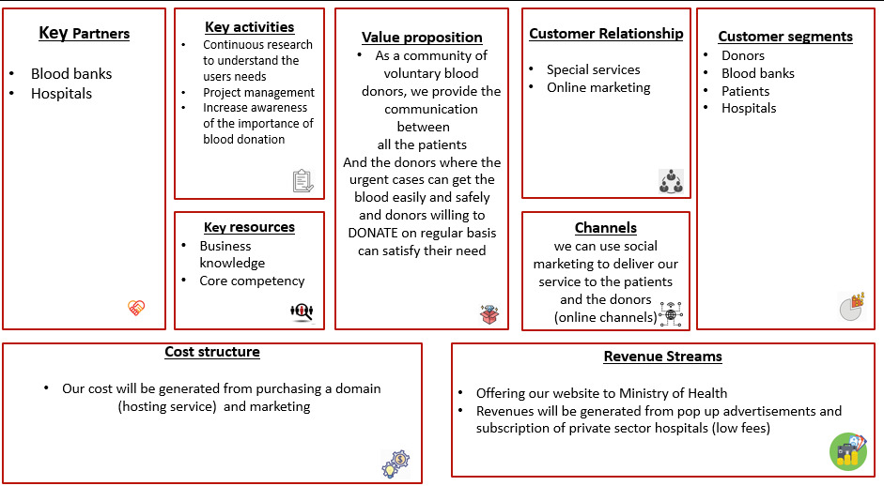
Business Model:

Slide 10
Analysis & Design:

Slide 11
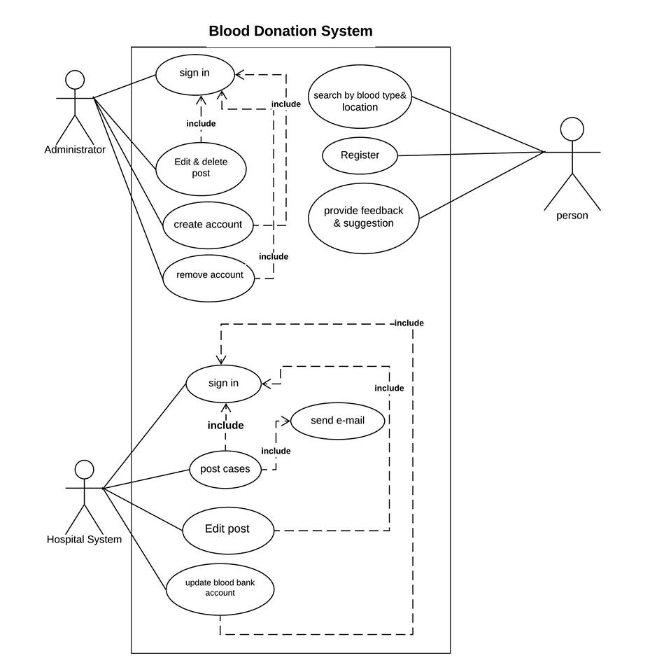
Use Case:

Slide 12
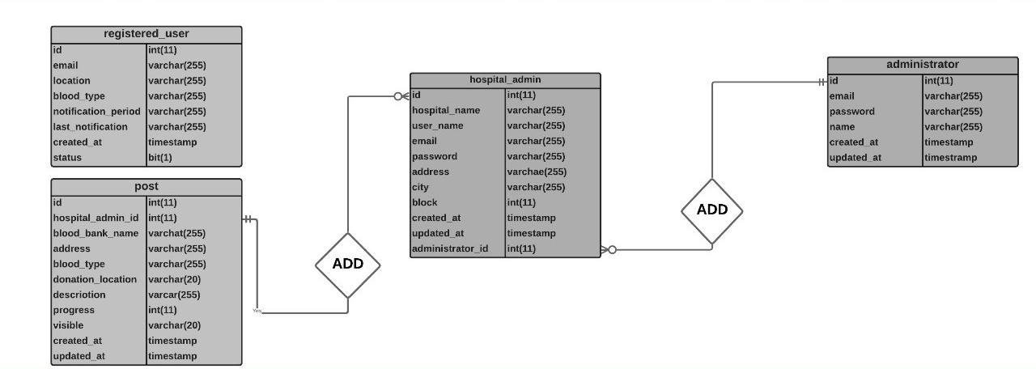
ERD:

Slide 13
Future Work
Expand our project in the future to cover more areas outside Alexandria till we cover all over Egypt to help a large amount of people by solving the blood donation problem facing the community.
So we are going to achieve this by:

Slide 14
(1). our main target is to get the confirmation from the ministry of health to use our website in their institutions -(Blood banks and governmental hospitals)- and our profit will be generated by handing our website over to them.
(2). Profit is resulting from private hospitals' subscriptions (small fee) and advertisements.
(3). Market to our website by collaborating with Community (Rotaract/Alpha Leo)and Charity Clubs (Resala/ Sonaa El-Hayah) ,making booths in Universities and Colleges, Our Facebook and Instgram Pages ,and joining any awareness events.
(4). To be in usual Contact with Blood-banks managers seeking for any assist ,future help in the donation process or in any update to our website system.
(5). We are targeting to merge with more blood-banks and hospitals outside Alexandria

Slide 15
Website demo

Slide 16
Save a life, give Blood

Slide 17
THANK YOU

